Slide 1
Image Segmentation

Slide 2
Image Segmentation
An important step in image analysis is to segment the image.
Segmentation: subdivides the image into its constituent parts or objects.
Autonomous segmentation is one of the most difficult tasks in image processing.
Segmentation algorithms for monochrome images generally are based on two basic properties of gray- level values:
Discontinuity 2. Similarity
2

Slide 3
Image Segmentation
Discontinuity: the image is partitioned based on abrupt changes in gray level.
Similarity: partition an image into regions that are similar
– Main approaches are thresholding, region growing and region splitting and merging.
3

Slide 4
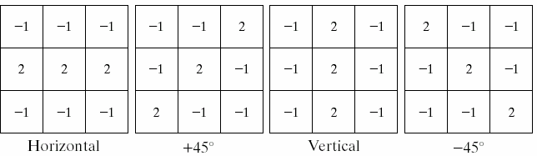

Detection of Discontinuities
Line detection: If each mask is moved around an image it would respond more strongly to lines in the mentioned direction.
4

Slide 5
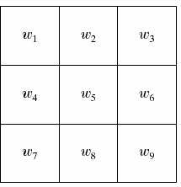
Detection of Discontinuities
There are 3 basic types of discontinuities in digital images:
Point
Line
Edges.
R = ∑ w_{i} z_{i}
i=1
9
Mask:
5

Slide 6
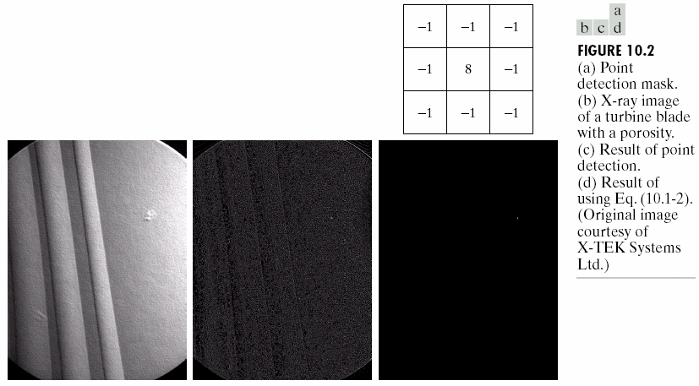
Detection of Discontinuities
Point detection: detect an isolated point
R ≥ T
6

Slide 7
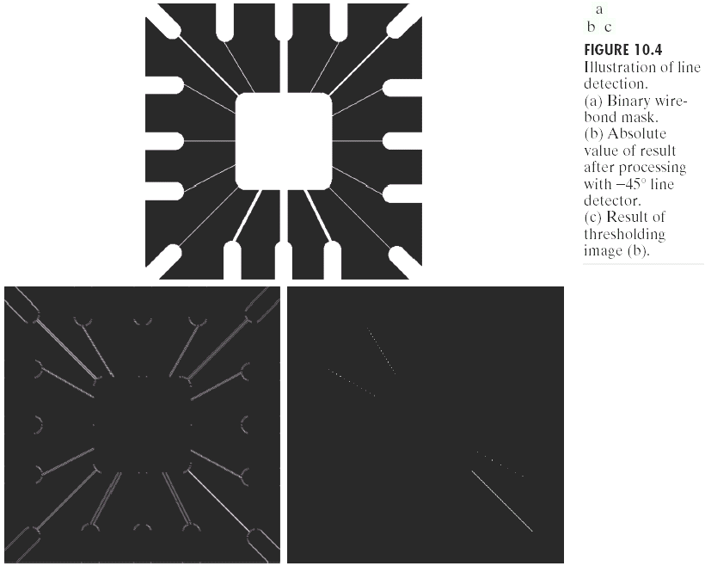
7

Slide 8
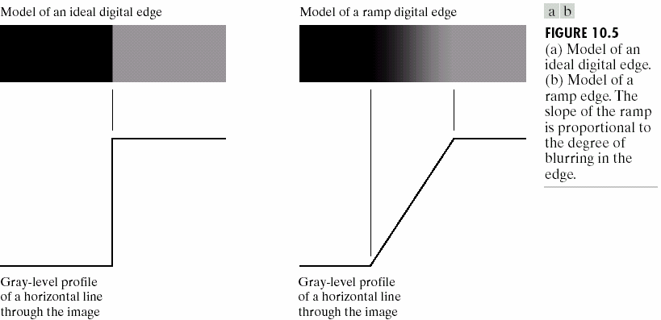
Edge detection
Edge: boundary between two regions with relatively distinct gray levels.
8

Slide 9
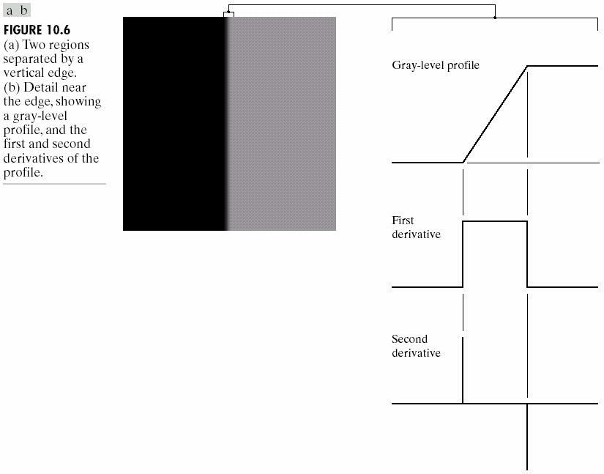
Edge detection
Basic idea: computation of a local derivative operator.
9

Slide 10
Edge detection
The magnitude of the first derivative can be used to detect an edge
The sign (zero crossing) of the second derivative can be used to detect an edge.
The same idea can be extended into 2-D. 2-D derivatives should be used.
The magnitude of the gradient and sign of the Laplacian are used.

Slide 11
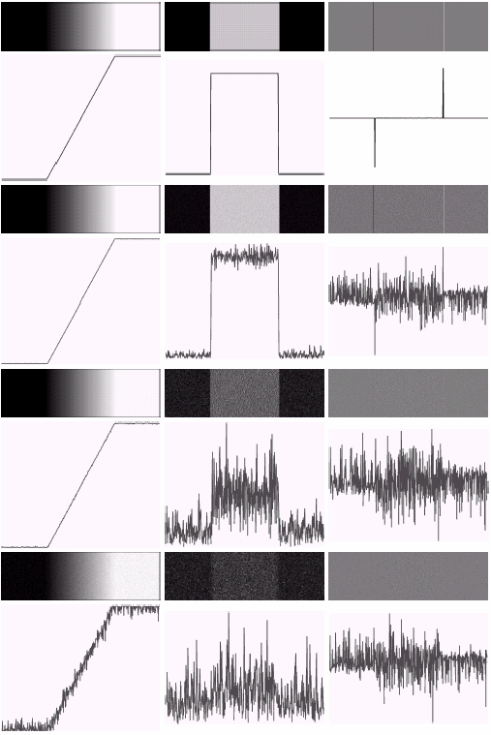

Slide 12
Gradient Operator
⎡∂f ⎤
⎡G_{x} ⎤
⎢ _{∂x} ⎥
Gradient
∇f = _{⎢G ⎥} = ⎢_{∂f} ⎥
⎣
y ⎦
⎢ ⎥
⎢_{⎣ ∂y} ⎥⎦
Gradient magnitude
∇f = mag(∇f ) = (G_{x} + G )
2 2
y
∇f ≈ G_{x} + G_{y}
Gradient direction
α (x, y) = tan⁻¹ (^{Gy} )
G_{x}

Slide 13
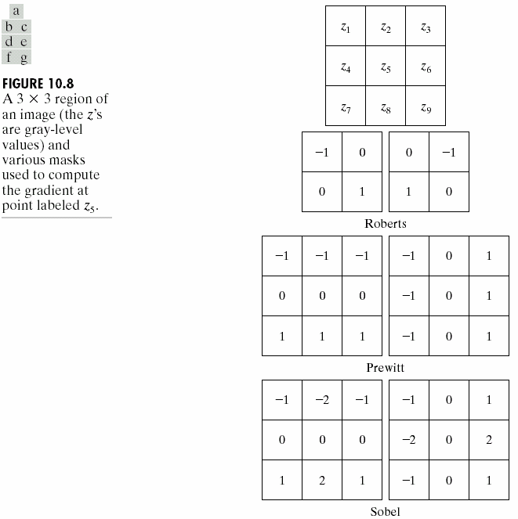

Slide 14
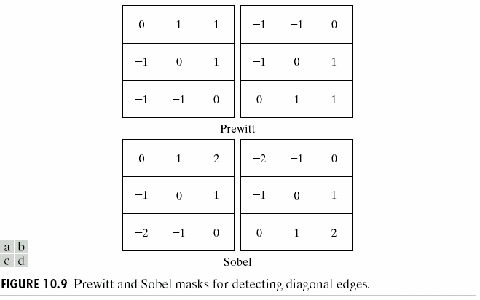

Slide 15
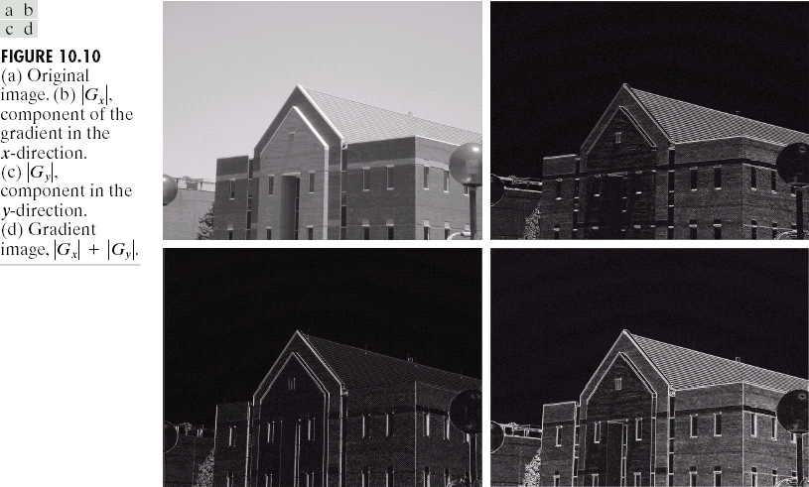

Slide 16
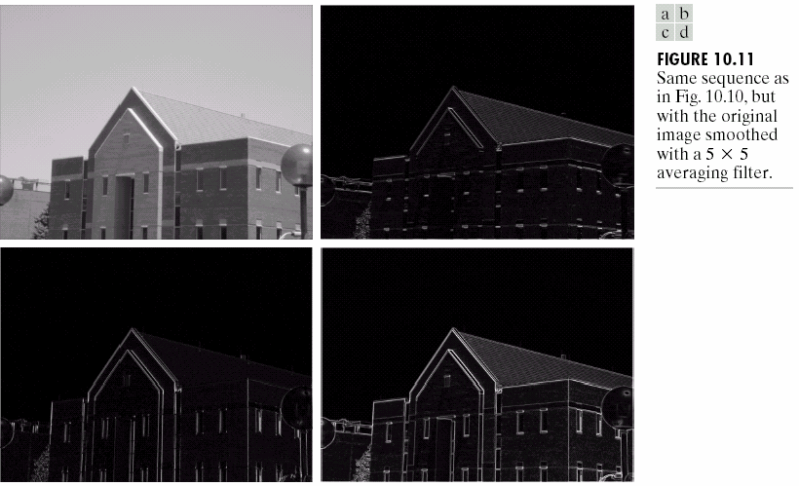

Slide 17
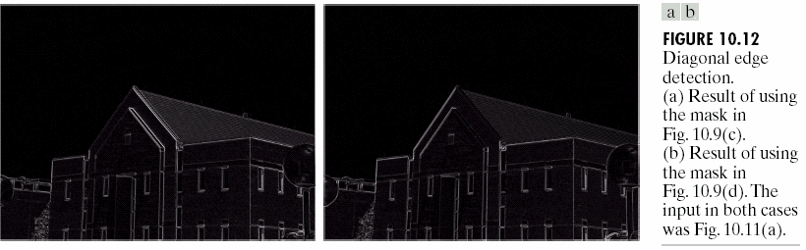

Slide 18
Laplacian
Laplacian in its original form is not used for edge detection because:
It is very sensitive to noise
It’s magnitude produces double edges
Unable to detect the direction of an edge.
To solve the first problem, the image is low-pass filtered before using the Laplacian operator.
f(x,y)
h(x,y)
∇2
g(x,y)

Slide 19
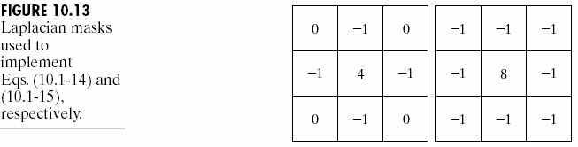
Laplacian
∇2
∂² f ∂² f
f = _{∂x2}
⁺ ∂y²
8
∇² f = 8z − ∑ z
5 i
∇² f = 4z
(z + z
z + z )
i=1
5
2
4
6
8

Slide 20
Laplacian
Convolution:
g(x, y) = f (x, y)*∇²h(x, y)
x + y
2 2
2σ ²
Gaussian function:
h(x, y) = exp(
r ² = x² + y²
)
r − σ ²
∇2
2
2
r
Second derivative:
h(r) = (
_{σ} 4
) exp(
2σ ² ⁾
•
•
Cross section of ∇²h has a Mexican hat shape.
The average ∇²h is zero. The average of image convolved
with ∇²h is also zero.
We will have negative pixel values in the result.

Slide 21
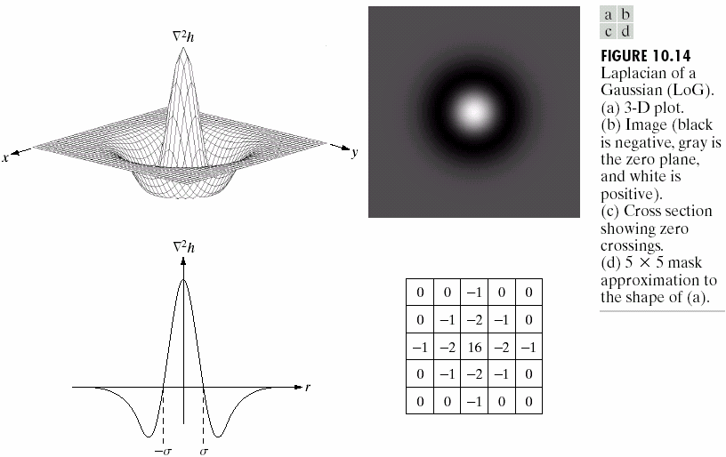
Laplacian
To solve the problem of double edges, zero crossing of the output of Laplacian operator is used.

Slide 22
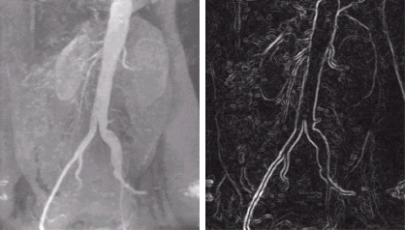
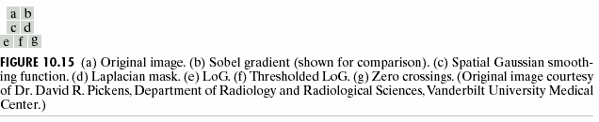

Slide 23
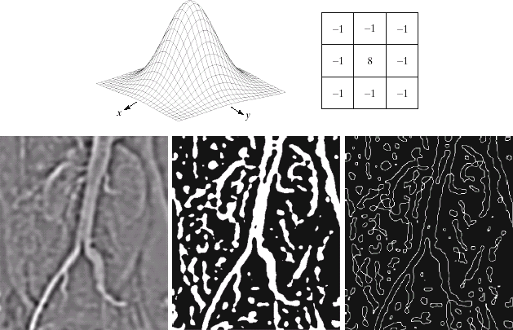
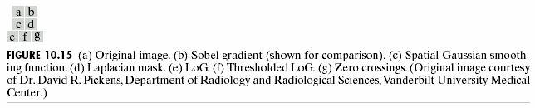

Slide 24
Edge linking and Boundary Detection
The output of discontinuity detection stage seldom characterizes a boundary completely.
This is because of noise, breaks in the boundary and other effects.
Edge detection algorithms typically are followed by linking and boundary detection procedures.
These procedures assemble edge pixels into meaningful boundaries.

Slide 25
Edge linking and Boundary Detection
All the points that are similar are linked forming a boundary of pixels.
Two principle properties used for establishing similarity of edge pixels in this kind of analysis are:
The strength of the response of the gradient operator used to produce the edge pixels
The direction of the gradient
∇f (x, y) − ∇f (x₀ + y₀ ) ≤ E
α (x, y) − α (x₀ , y₀ ) < A

Slide 26
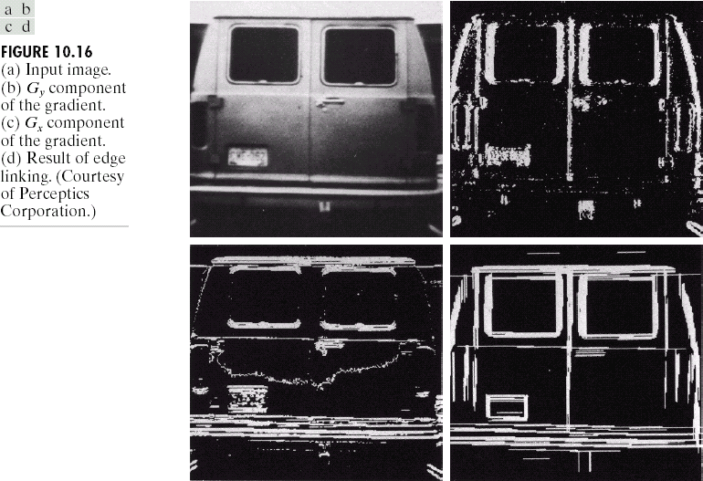

Slide 27
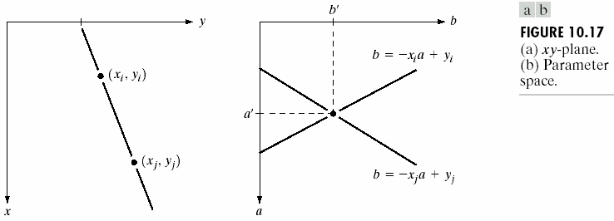
Hough Transform
(x_{i},y_{i}): all the lines passing this point y_{i}=ax_{i}+b
b= y_{i}-ax_{i} : point (x_{i},y_{i}) maps to a single line in ab plane.
Another point (x_{j},y_{j}) also has a single line in ab plane
b= y_{j}-ax_{j}
a’ and b’ are the slope and intercept of the line containing both (x_{i},y_{i}) and (x_{j},y_{j}).

Slide 28
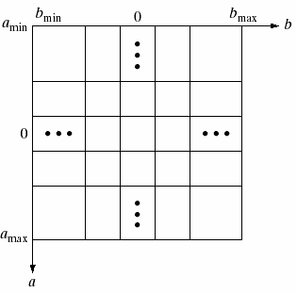
Hough transform
(a_{min},a_{max}): expected range of slope
(b_{min},b_{max}): expected range of intercepts
A(i,j): the number of points in the cell at coordinates (i,j) in the ab plane.
For every point in the image plane, we let the value of a equal each of the allowed subdivisions and find the corresponding b from
b= y_{i}-ax_{i} If for a_{p} we get b_{q}
the A(p,q) is incremented.

Slide 29
Hough transform
The cell with the largest value shows the parameters of the line that contains the maximum number of points.
Problem with this method: a approaches infinity as the line gets perpendicular to the x axis.
Solution: use the representation of the line as:
x cosθ + y sinθ = ρ

Slide 30
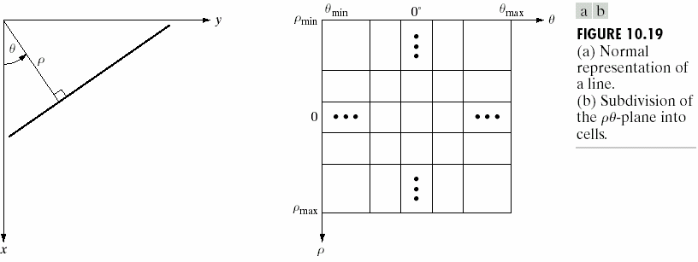
Hough transform
A point in xy plane is mapped into a sinusoidal curve in ρθ plane.

Slide 31
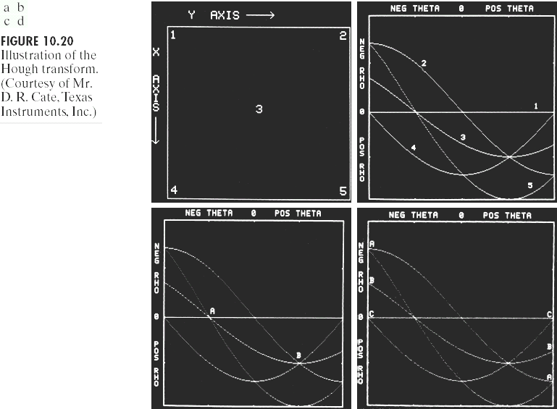

Slide 32
Hough transform
Hough transform is applicable to any function of the form g(v,c)=0, where v is the vector of coordinates and c is the vector of coefficients.
Exp: (x − c )² + ( y − c )² = c ²
1 2 3
3 parameters (c1,c2,c3), 3-D parameter space, cube like cells, accumulators of the form A(i,j,k).
Procedure:
Increment c1 and c2
Solve for c3
Update the accumulator associated with (c1,c2,c3)

Slide 33
Thresholding
Thresholding is one of the most important approaches to image segmentation.
Gray level histogram of an image f(x,y) composed of a light object on a dark background.
To extract the object: select a threshold T that separates the gray levels of the background and the object.

Slide 34
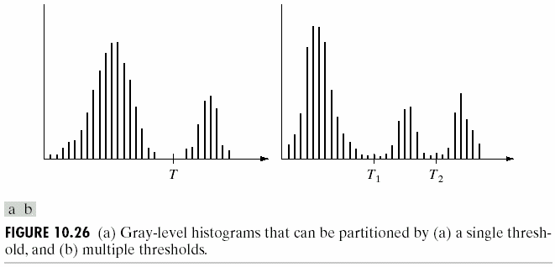
Thresholding
Single threshold: points with f(x,y)>T belong to object; other points belong to background.
Multiple thresholds: points with f(x,y)>T₂ belong to object; points with f(x,y)<T₁ belong to bakground.

Slide 35
Thresholding
Threshold in general can be calculated as:
T=T(x,y,p(x,y),f(x,y)) f(x,y): gray level at (x,y)
p(x,y): some local property of the point (x,y) (e.g., the average gray level of a neighborhood centered on (x,y).
T depends only on f(x,y): global threshold
T depends on f(x,y) and p(x,y): local threshold
T depends on f(x,y) and p(x,y) and x,y : dynamic threshold

Slide 36
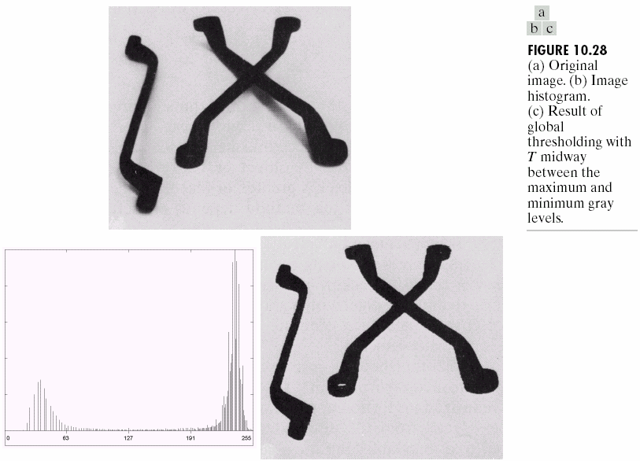
Thresholding

Slide 37
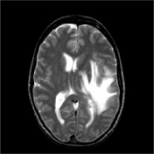
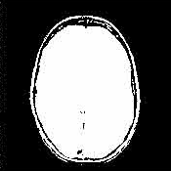
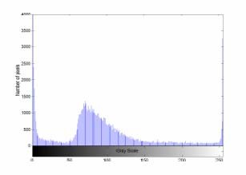
Thresholding
MR brain image (top left), its histogram (bottom) and the segmented image (top right) using a threshold T=12 at the first major valley point in the histogram.

Slide 38
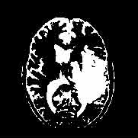

Thresholding
Two segmented MR brain images using a gray value threshold T=166 (top right) and T=225 (bottom)

Slide 39
Basic Global Thresholding
Select an initial estimate for T
Segment the image using T. This will produce two group of pixels G1 (with gray level greater than T) and G2 (with gray level less than T)
Compute average gray level values μ1 and μ2 for pixels in regions G1 and G2
Compute a new threshold: T=(μ1+ μ2)/2
Repeat step 2 through 4 until the difference in T in successive iterations is smaller than a predefined value

Slide 40
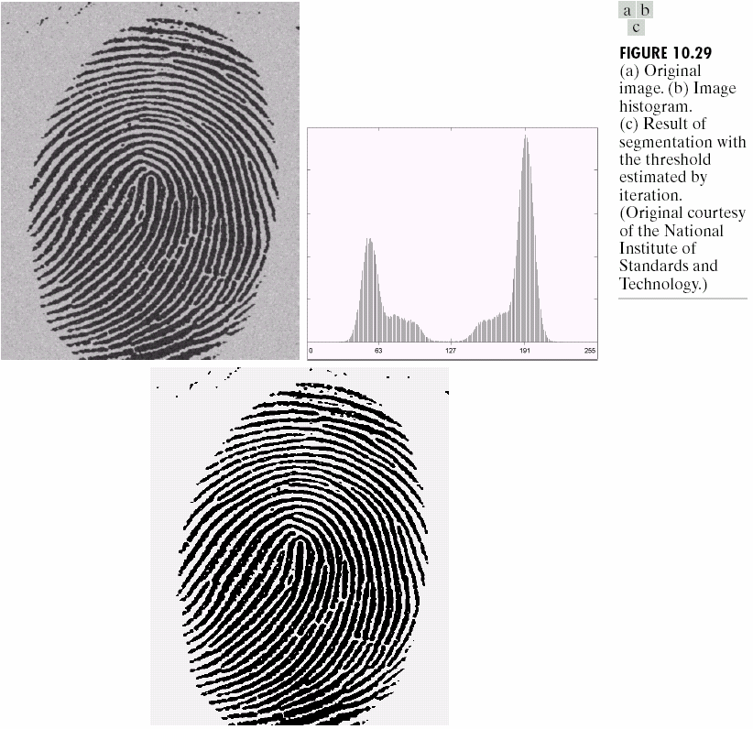
Basic Global Thresholding

Slide 41
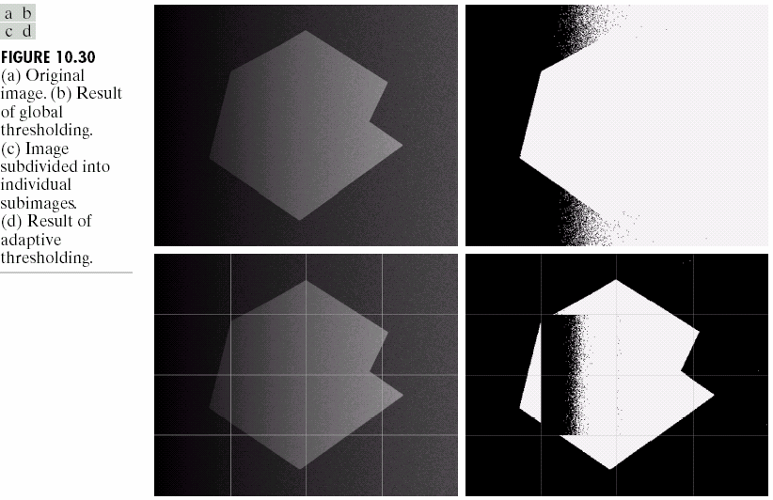
Basic Adaptive (Local) Thresholding

Slide 42
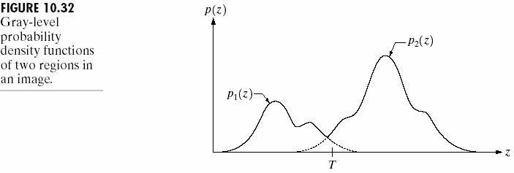
Optimal Global Thresholding
p(z) = P₁ ⋅ p₁ (z) + P₂ ⋅ p₂ (z)
P₁ + P₂ = 1
Problem: how to optimally determine T to minimize the segmentation error?

Slide 43
∫
Optimal Global Thresholding
E (T ) =
T
p (z)dz
Error 1:
1
−∞
2
E₂ (T ) = _{∫T} p₁ (z)dz
∞
Error 2:
Total error: E(T ) = P₁E₂ (T ) + P₂ E₁ (T )
Goal: what’s the value of T to minimize E(T)?
P₁ p₁ (T ) = P₂ p₂ (T )
Result:

Slide 44
(z − μ )² P (z − μ )²
Optimal Global Thresholding: Gaussian PDFs
P
p(z) = ¹ exp(− ¹ ) + ² exp(− ² )
2πσ
2σ
2
1
2πσ
2σ
2
2
1
2
AT ² + BT + C = 0
Solution:
A = σ − σ
2
1
2
2
B = 2(μ σ
− μ σ )
2
1 2
2
2 1
C = σ μ
− σ μ
+ 2σ 2
σ
ln(σ ₂ P₁ / σ₁P₂ )
2 2
2 2
2
2
2
1 2
2 1
1

Slide 45
Region Based Segmentation
Let R represent the entire image. Segmentation is a process that partitions R into n subregions R1,R2,…,Rn such that:
n
a) ∪ R_{i}
= R
i =1
R _{i} is a connected region.
R _{i} ∩ R _{j} = φ
P(R _{i} ) = True
P(R _{i} ∪ R _{j} ) = False

Slide 46
Region Growing
Pixel aggregation: starts with a set of seed point and from these grows regions by appending to each seed point those neighboring pixels that have similar properties (e.g., gray-level, texture, color).

Slide 47
Region Growing
Center Pixel
Pixels satisfying the similarity criterion
Pixels unsatisfying the criterion 3x3 neighborhood
5x5 neighborhood 7x7 neighborhood
Segmented region

Slide 48
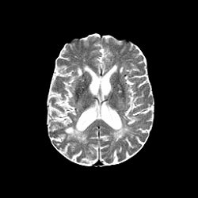

Region Growing
A T-2 weighted MR brain image (left) and the segmented ventricles (right) using the region-growing method.

Slide 49
Region growing
Problems:
Selection of initial seeds that properly represent regions of interest
Selection of suitable properties
Formulation of a stopping rule.

Slide 50
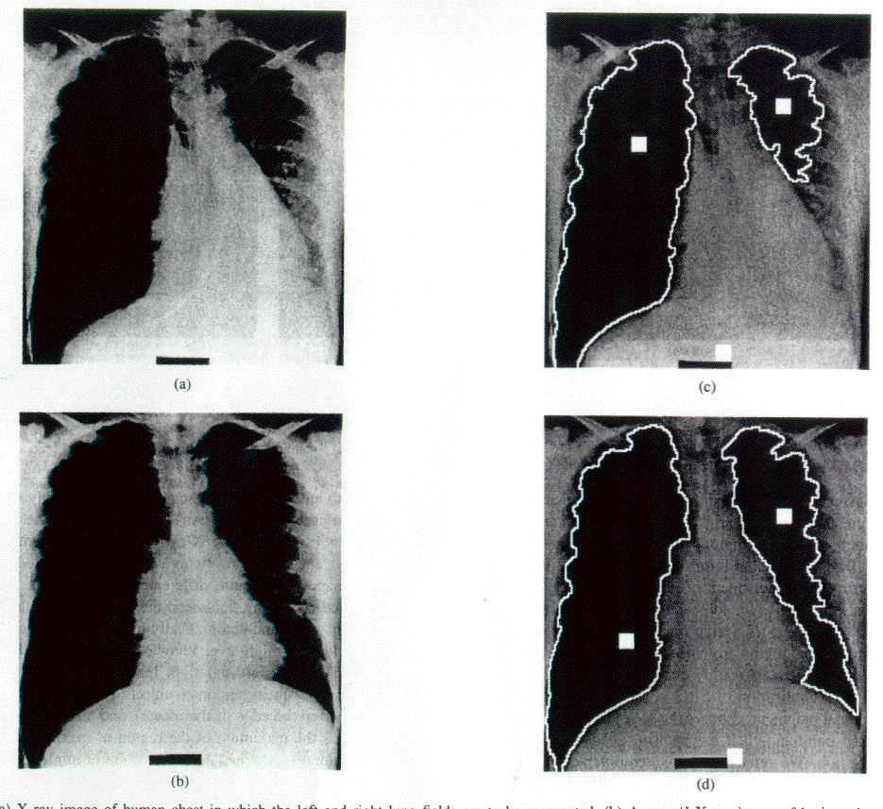
Seeded Region Growing

Slide 51
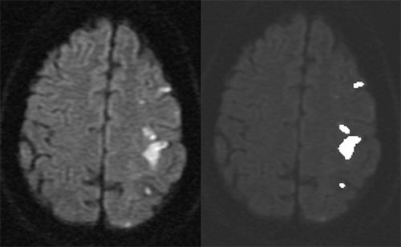
Region Growing in a Diffusion Weighted Image

Slide 52
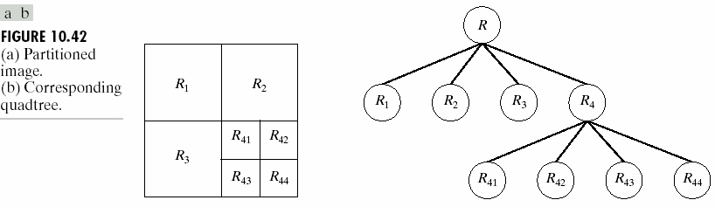
Region Splitting and Merging
Sub-divide an image into a set of disjoint regions and then merge and/or split the regions in an attempt to satisfy the condition (P).

Slide 53
Region Splitting and Merging
Procedure:
Split into 4 disjoint quadrants any region Ri where P(Ri)= False.
Merge any adjacent regions R_{j} and R_{k} for which P(R_{j} U R_{k})= True.
Stop when no further merging or splitting is possible.

Slide 54
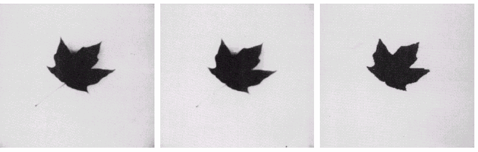
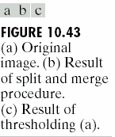
Region Splitting and Merging

